Slide 1

Edit Distance

Slide 2
Introduction
Given two strings str1 and str2 of length M and N respectively and below operations that can be performed on str1. Find the minimum number of edits (operations) to convert ‘str1‘ into ‘str2‘.
Operation 1 (INSERT)
Operation 2 (REMOVE)
Operation 3 (Replace)
Example1 : Input: X[]=“cat” Y[] = “cut” Output=1
Example2 : Input: X[]=“horse” Y[] = “ros” Output=3
Example3 : Input: X[]=“sunday” Y[] = “saturday” Output=3
Example4 : Input: X[]=“intention” Y[] = “execution” Output=5

Slide 3
Solution Approaches
Brute force recursive approach
Dynamic Programming

Slide 4
Brute force approach
The idea is to process all characters one by one starting from either from left or right sides of both strings.
Process from the right end of the strings, there are two possibilities for every pair of characters being traversed, either they match or they don’t match.
If last characters of both string matches then there is no need to perform any operation So, recursively calculate the answer for rest of part of the strings.
When last characters do not match, we can perform all three operations to match the last characters in the given strings, i.e. insert, replace, and remove.
We then recursively calculate the result for the remaining part of the string. Upon completion of these operations, we will select the minimum answer.

Slide 5
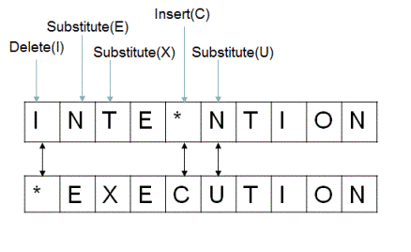
Recurrence Relation for edit distance
editDistance(X,Y,m,n)
if(m==0)
return n
if(n==0) base case
return m
if(X[m-1]==Y[n-1])
return editDistance(X,Y,m-1,n-1)
else
{
return 1+min({editDistance(X,Y,m,n-1),editDistance(X,Y,m-1,n), editDistance(X,Y, m-1,n-1)}
}

Slide 6
Example
To convert BIRD to HEARD, I would need to make 3 changes, those being:
Replacing ‘I’ of BIRD with ‘A’. Thus, BIRD now changes to BARD.
Replacing ‘B’ of BIRD with ‘E’. Hence, it further changes to EARD.
Adding H at the beginning. Finally, we get HEARD.

Slide 7
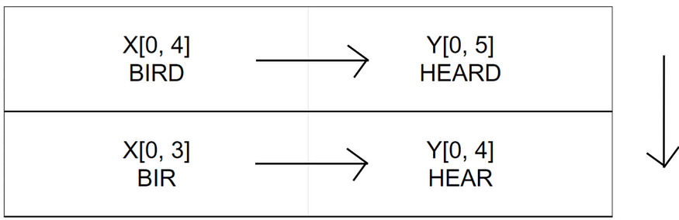
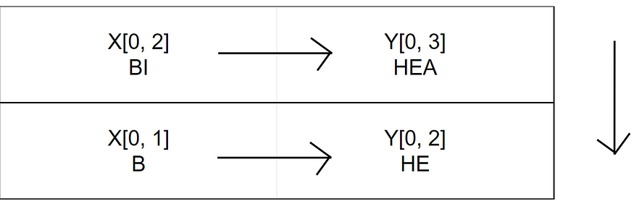
Example
Do nothing
Replace: To convert ‘BI’ to ‘HEA’, then notice that the last characters of those strings are different. Hence to convert ‘BI’ to ‘HEA’, we just need to convert ‘B’ to ‘HE’ and simply replace the ‘I’ in ‘BI’ to ‘A’. This way we have changed the string to ‘BA’ instead of ‘BI’. So now, we just need to calculate the distance between the strings minus the last character. Hence our edit distance of ‘BI’ and ‘HEA’ is 1 + edit distance of ‘B’ and ‘HE’.

Slide 8
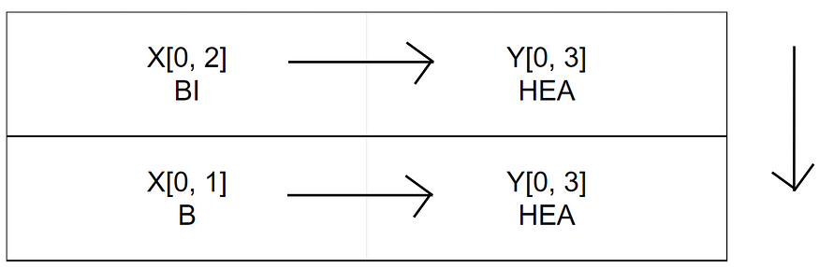
Example
Deletion: if we want to convert ‘BI’ to ‘HEA’, we can simply drop the ‘I’ from ‘BI’ and then find the edit distance between the rest of the strings. Remember, if the last character is a mismatch simply delete the last character and find edit distance of the rest.

Slide 9
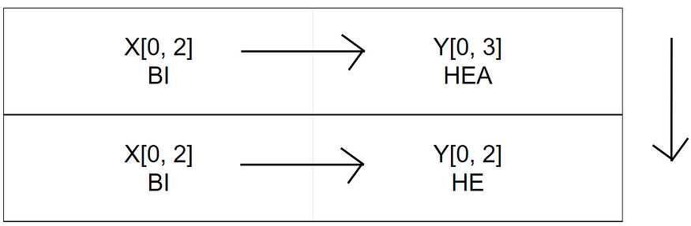
Example
Insertion: One possible solution is to drop ‘A’ from ‘HEA’. This way we’ll end up with ‘BI’ and ‘HE’, after finding the distance between these substrings, because if we find the distance successfully, we’ll just have to simply insert an ‘A’ at the end of ‘BI’ to solve the sub problem.

Slide 10
Base Case
In order to convert an empty string to any string “xyz”, we essentially need to insert all the missing characters in our empty string. Hence, in order to convert an empty string to a string of length m, we need to do m insertions; hence our edit distance would become m.
Similarly in order to convert a string of length m to an empty string “” we need to perform m number of deletions; hence our edit distance becomes m.
Take the minimum of these operations and add one to it because we’re performing an operation on these two characters that didn’t match.

Slide 11

Edit Distance using Dynamic Programming

Slide 12
Using Dynamic Programming
In Dynamic Programming algorithm we solve each sub problem just once and then save the answer in a table.
Steps
editDistance(X,Y,m,n,DP).
Base Condition : if (m==0) return n and if(n==0) then return m.
if(DP[m][n]!=-1) return DP[m][n]
If (X[m-1]==Y[n-1]) we recursively call the editDistance(X,Y,m-1,n-1,DP) to compute the edit distance without considering the last character and will store DP[m][n].
If(X[m-1]!=Y[n-1] then
editDistance(X,Y,m,n-1,DP)
editDistance(X,Y,m-1,n,DP)
editDistance(X,Y,m-1,n-1,DP)
Compute the minimum of above and add 1 because of the operation performed and store the result in DP[m][n]

Slide 13
Algorithm
editDistance(X,Y,m,n, DP)
{
if(m==0)
return n
if(n==0)
return m
if(DP[m][n]!=-1)
return DP[m][n]
if(X[m-1]==Y[n-1])
DP[m][n]=editDistance(X,Y,m-1,n-1,DP)
else
{
DP[m][n]=1+min({editDistance(X,Y,m,n-1,DP),
min(editDistance(X,Y,m-1,n,DP),
min(editDistance(X,Y,m-1,n-1,DP)})
}
return DP[m][n]

Slide 14
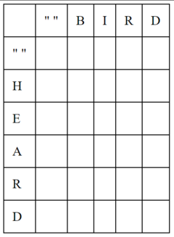
Writing all the characters in our strings. Put the string to be changed in the horizontal axis and the source string on the vertical axis.
Fill base case values.

Slide 15
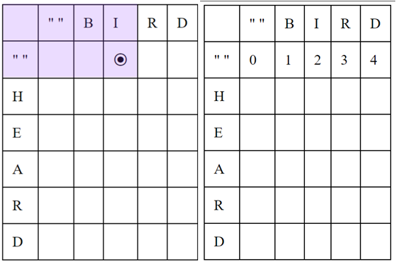
Edit distance to convert any string to an empty string is the length of the string itself. So, the edit distance to convert “B” to empty string is 1; to convert “BI” to empty string is 2 and so on.

Slide 16
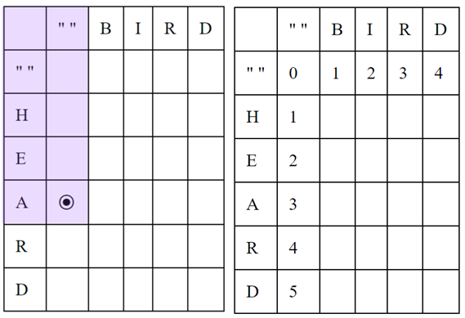
Similarly, to convert an empty string to a string of length m, we would need m insertions. Thus, to convert an empty string to “HEA” the distance is 3; to convert to “HE” the distance is 2 and so on.

Slide 17
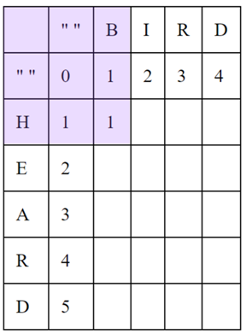
Consider the next case where we have to convert “B” to “H”. Here we will perform a simple replace operation. We want to take the minimum of these operations and add one when there is a mismatch. So, in the table, we will just take the minimum value between cells [i-1,j], [i-1, j-1] and [i, j-1] and add one. In this case, we take 0 from diagonal cell and add one i.e. we performed a replace operation.
When the two characters match, we simply take the value of the [i-1,j-1] cell and place it in the place without any incrementation.

Slide 18
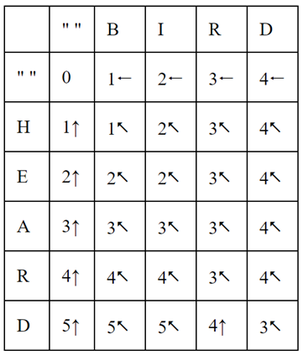
After filling up the table

Slide 19
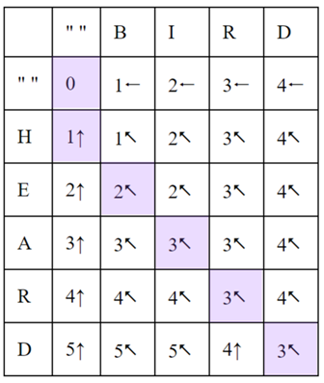
Getting the result
We start with cell [5,4] where our value is 3 with a diagonal arrow. But since the characters at those positions are the same, we don’t need to perform an operation. Hence, we simply move to cell [4,3]
In cell [4,3] we also have a matching set of characters so we move to [3,2] without doing anything.
At [3,2] we have mismatched characters with a diagonal arrow indicating a replacement operation. Hence, we replace ‘I’ in ‘BIRD’ with ‘A’ and again follow the arrow.
At [2,1] we again have mismatched characters similar to point 3 so we simply replace ‘B’ with ‘E’ and move forward.
At [1,0] we have an upwards arrow meaning insertion. Hence we insert ‘H’ at the beginning of our string then we’ll finally have ‘HEARD’.

